Slide 1
THANK YOU FOR DOWNLOADING!
HOPE IT HELPS WITH YOUR PRESENTATIONS
IN CASE THE EMBEDDED FONTS DON’T WORK, HERE ARE THE DOWNLOAD LINKS:
ARCHIVO
https://fonts.google.com/specimen/Archivo
SPECIAL ELITE
https://fonts.google.com/specimen/Special+Elite

Slide 2


Slide 3


FOR, AFTER ALL, HOW DO WE KNOW THAT TWO AND TWO MAKE FOUR? OR THAT THE FORCE OF GRAVITY WORKS? OR THAT THE PAST IS UNCHANGEABLE? IF BOTH THE PAST AND THE EXTERNAL WORLD EXIST ONLY IN THE MIND, AND IF THE MIND ITSELF IS CONTROLLABLE – WHAT THEN?
NINETEEN
ORWELL
EIGHTY
THE WORLD EP.1
MOVEMENT
FOUR GEORGE
Notes:
https://lordicon.com/">Animated icons by Lordicon.com

Slide 4


NAME
WINSTON SMITH
MEMBER OF
OUTER PARTY
OCCUPATION
EDITOR, FICTION DEPARTMENT, MINISTRY OF TRUTH
>>>>AZ1984>>>>>>>THE>>>WORLD>>>>>>>>>>>>>>>>>>>>EP>>>01>>>>>>>MOVEMENT

Slide 5
NAME
WINSTON SMITH
MEMBER OF
OUTER PARTY
OCCUPATION
EDITOR, FICTION DEPARTMENT, MINISTRY OF TRUTH
>>>>AZ1984>>>>>>>THE>>>WORLD>>>>>>> >>>>>>>>>>>>>EP>>>01>>>>>>>MOVEMENT

Slide 6

NAME
JULIA
MEMBER OF
OUTER PARTY
OCCUPATION
MACHINE OPERATOR, FICTION DEPARTMENT, MINISTRY OF TRUTH
>>>>AZ1984>>>>>>>THE>>>WORLD>>>>>>> >>>>>>>>>>>>>EP>>>01>>>>>>>MOVEMENT

Slide 7

NAME
O’BRIEN
MEMBER OF
INNER PARTY
OCCUPATION
ADMINISTRATOR, MINISTRY OF TRUTH
>>>>AZ1984>>>>>>>THE>>>WORLD>>>>>>> >>>>>>>>>>>>>EP>>>01>>>>>>>MOVEMENT

Slide 8
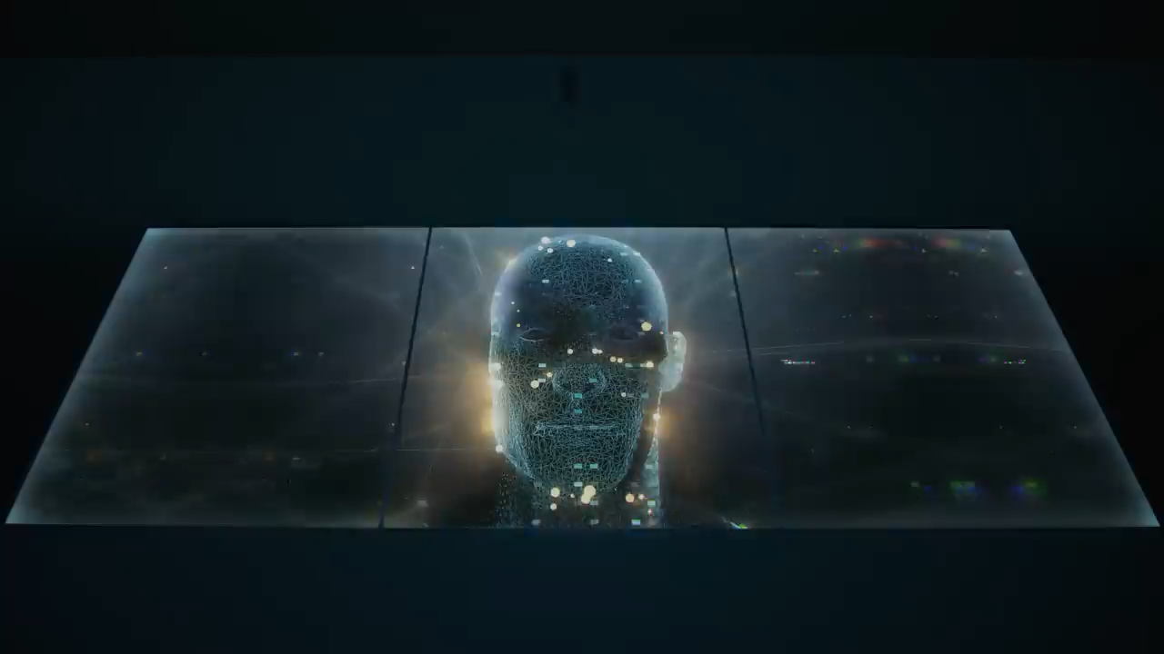
NEWSPEAK
SIMPLIFIED VERSION OF ENGLISH THAT TAKES AWAY PEOPLE'S ABILITY TO EXPRESS COMPLEX THOUGHTS AND IDEAS.

Slide 9

XXXXXXXXXXXXXXXXXXXXXXXXXXXXXXXXXXXXXXXXXXXXXXXXXXXXXXXXXXXXXXXXXXXXXXXXXXXXXXXXXXXXX
LEADER OF OCEANIA
BIG BROTHER IS WATCHING YOU
NUMBER_08_001012_99080994
XXXXXXXXXXXXXXXXXXXXXXXXXXXXXXXXXXXXXXXXXXXXXXXXXXXXXXXXXXXXXXXXXXXXXXXXXXXXXXXXXXXXX

Slide 10

THOUGHTCRIME
Thoughts that go against the political ideology of the Party
Frighten citizens into policing their own thoughts
Rather preserve their lives and betray their beliefs
Examples:
Talking egatively about Big Brother
Hoping the party would fail
Doubting Oceania’s war
Sexual desire towards another person

Slide 11


VAPOURISE
WHEN A PERSON IS SECRETLY MURDERED AND ERASED FROM SOCIETY, THE PRESENT, THE UNIVERSE, AND EXISTENCE.

Slide 12

DOUBLE
Lies Betray Control Selfishness Rule Contradict Numb Rules Hatred Selfishness Emptiness Hatred Selfishness Emptiness Repression Numb Surveillance Contradict Cruelty Selfishness Betray Emptiness
THINK
2+2 =5
W@R IS PEACE
FREEDOM IS SL@VERY,
IGNORANCE IS STRENGTH

